Slide 1

Pricing Analysis
BIG MOUNTAIN RESORT
July 6, 2023
Data Science Team

Slide 2

Agenda
Problem Identification
Recommendation and Key findings
Modeling
Analysis
Results
Conclusion

Slide 3

Problem Identification
Big Mountain Resort, a ski resort located in Montana, wants to improve their pricing strategy and maximize their revenue. The resort currently charges a premium price in the market segment but lacks an understanding of the value of its facilities relative to others.
Management wants to implement a data-driven approach, which aims to provide insights into the importance of different facilities, identify opportunities for cost-cutting measures, and support informed decisions regarding ticket pricing.

Slide 4

Recommendations and Key Findings
Recommendations
Key Findings
Based on our modeling analysis there is room to raise the ticket price for Big Mountain resort
Scenario two will provide the highest gain in revenue with the lease amount of cost
The most relevant features to ticket price based on the model are Fast Quads and Runs
Big Mountain Resort is on the higher end of resorts that contain features most relevant to price, justifying the premium price
Data on operating costs and visitor telemetry would inform a more accurate model

Slide 5
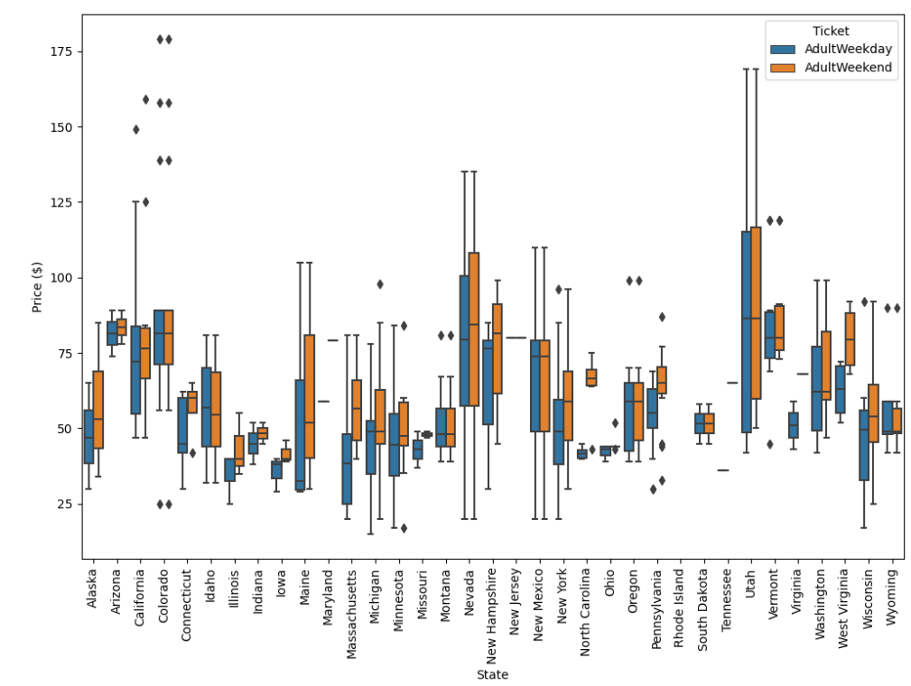
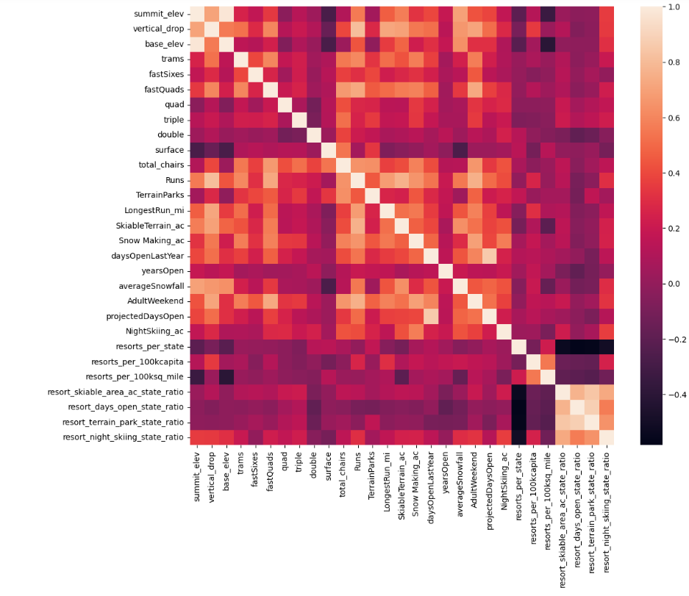
Modeling Analysis (1/3)
There is no clear pattern between state and ticket pricing.
Heatmap depicting correlation between the various features of the resort

Slide 6
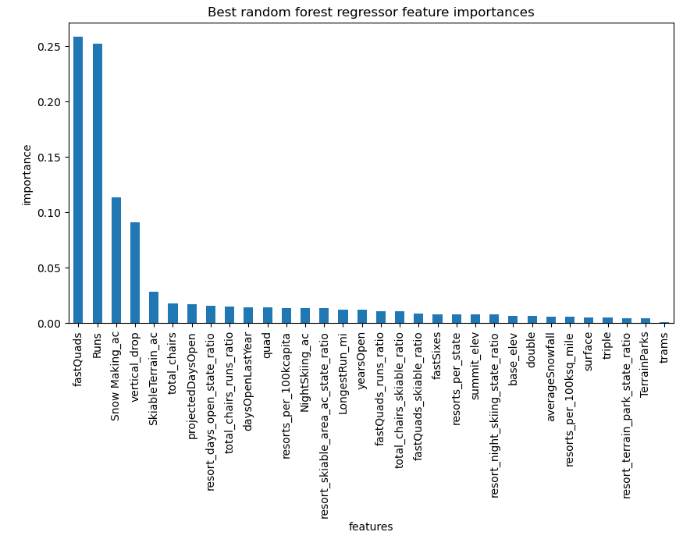
Modeling Analysis (2/3)
Model | Mean | Standard Deviation | Mean Absolute Error
Linear Regression | 10.50 | 1.62 | 11.79
Random Forest Regression | 9.64 | 1.35 | 9.54
The most relevant features to price are Fast Quads and Runs
The random forest model has a lower cross-validation mean absolute error by almost $1. It also exhibits less variability. Due to this it was chosen as the model to move forward with

Slide 7
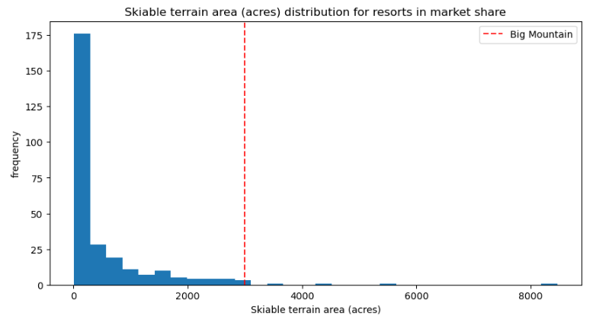
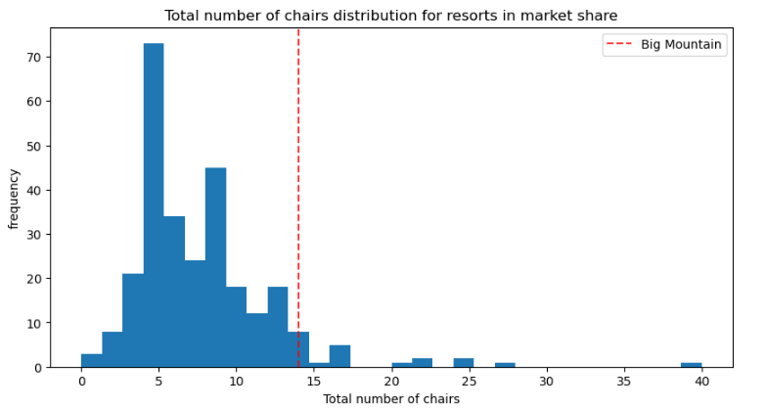
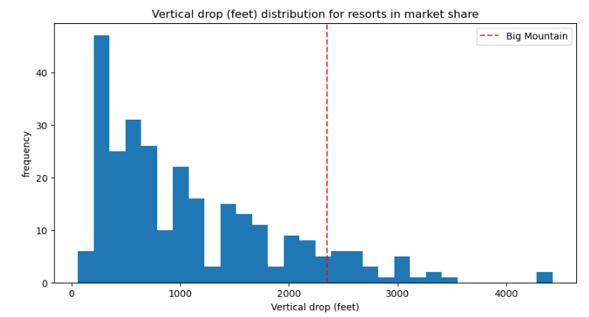
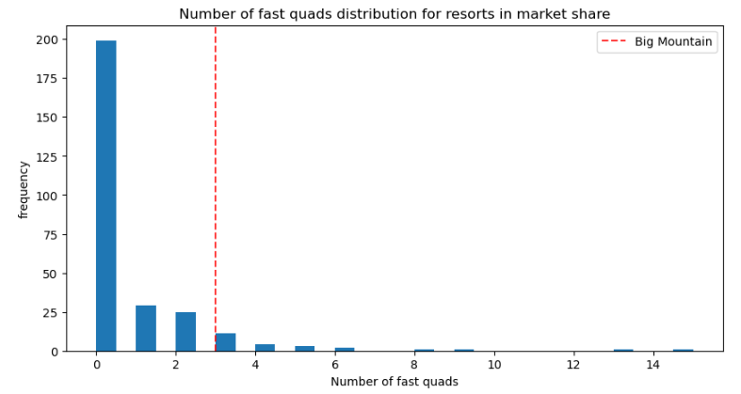
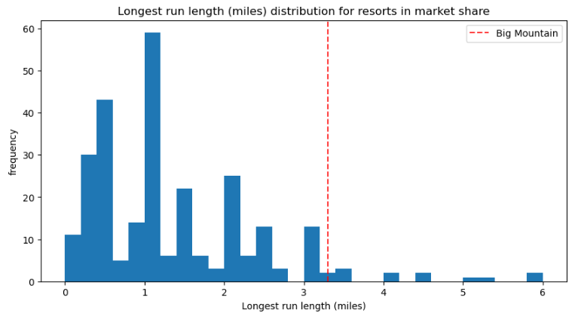
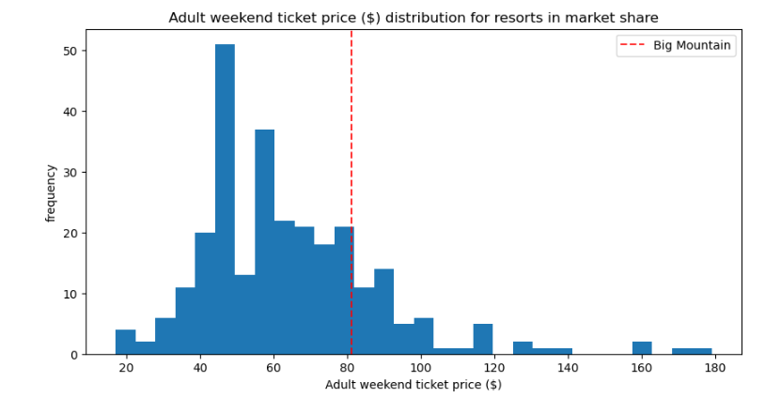
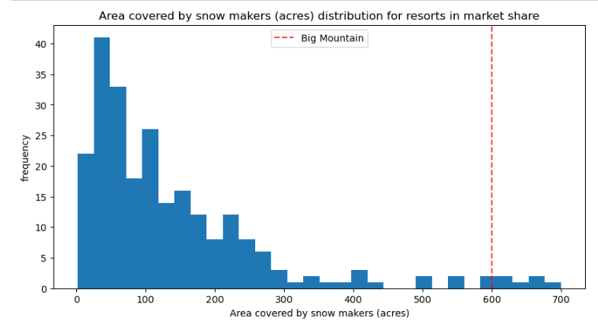
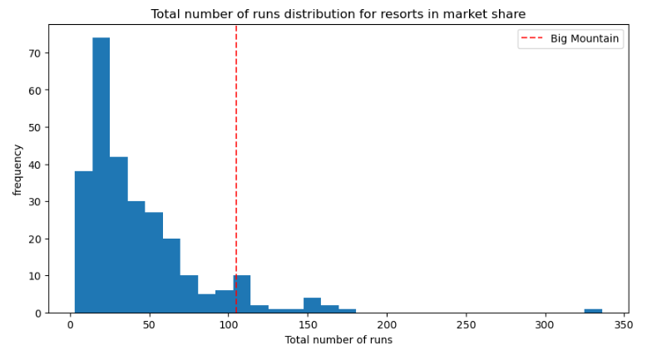
Modeling Analysis (3/3)
Big mountain resort has one of the larger vertical drops compared to other resorts
Big mountain resort has more fast quads than most other resorts
Big mountain resort is one of the largest resorts in terms of skiable terrain
Big mountain resort has more chairs than most other resorts
Big mountain resort has nearly the highest amount of area covered by snow makers
Big mountain resort has over 100 runs which is more than most other resorts
Big mountain resort has over a 3-mile run
Big mountain resort’s ticket price is on the higher end but is not the most

Slide 8
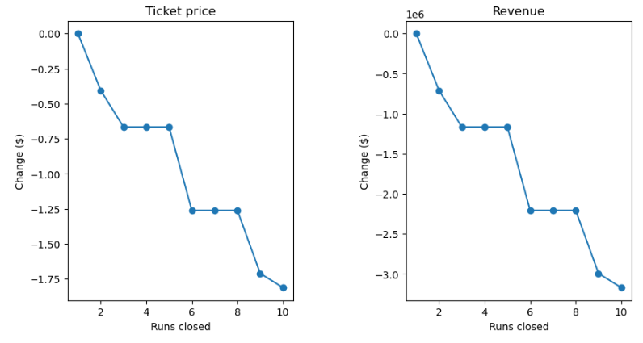
Modeling Results
The model predicts that the optimal price per ticket at Big Mountain resort is $95.87. Although this is a premium price, it is justified since Big Mountain has above the average features that are most influential to ticket price.
Scenario 1 - Permanently closing 10 of the least used runs
Scenario 3 – Same as Scenario 2, but adding 2 acres of snow making cover
The model predicts that this would yield the same increase in ticket price as Scenario 2; however, the cost associated with creating more snow making machines would not be covered by the additional snow making area
Closing one run makes no difference. Closing 2 and 3 successively reduces support for ticket price and so revenue. If Big Mountain closes 3 runs, it seems they may as well close 4 or 5 as there's no further loss in ticket price. Increasing the closures to 6 or more leads to a large drop.
Scenario 2 - Increase vertical drop by adding a run to a point 150 feet lower down. Requiring the installation of an additional chair lift, without additional snow making coverage
The model predicts that this scenario would increase support for ticket price by $1.99, which would result in an additional $3.47m over the season
Scenario 4 - Increase the longest run by 0.2 mile to boast 3.5 miles length, requiring an additional snow making coverage of 4 acres
Making this change would not justify any increase in ticket price as the longest run feature is not impactful on ticket price

Slide 9

Conclusion
The optimal price based on the current features of the resort compared to other resorts is roughly $96 compared to the current price of $81 with a mean absolute error of $10.39.
This means that there is room for an increase in price; however, the validity of the model lies in the assumption that other resorts accurately set their prices according to what the market (the ticket-buying public) supports.
Model 2 is predicted to increase support for ticket prices by $1.99 and potentially generate around $3,474,638 in additional revenue over the season based on 350,000 visitors per season

